Slide 1
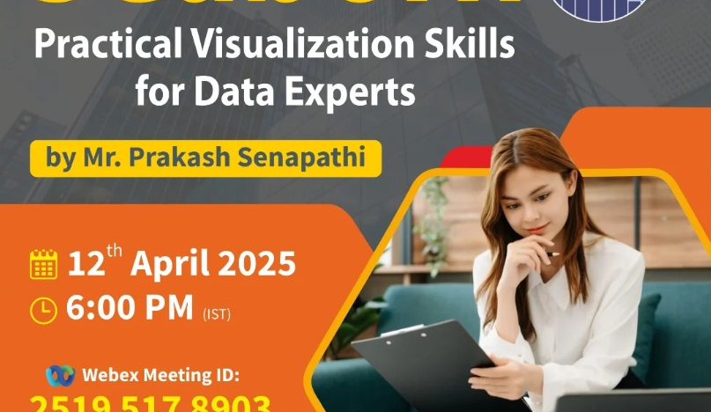

Welcome to Seaborn Bootcamp
K. Prakash Senapati

Slide 2

WEBEX → Meeting Id: 2516 634 7739 Pwd: 112233

Slide 3
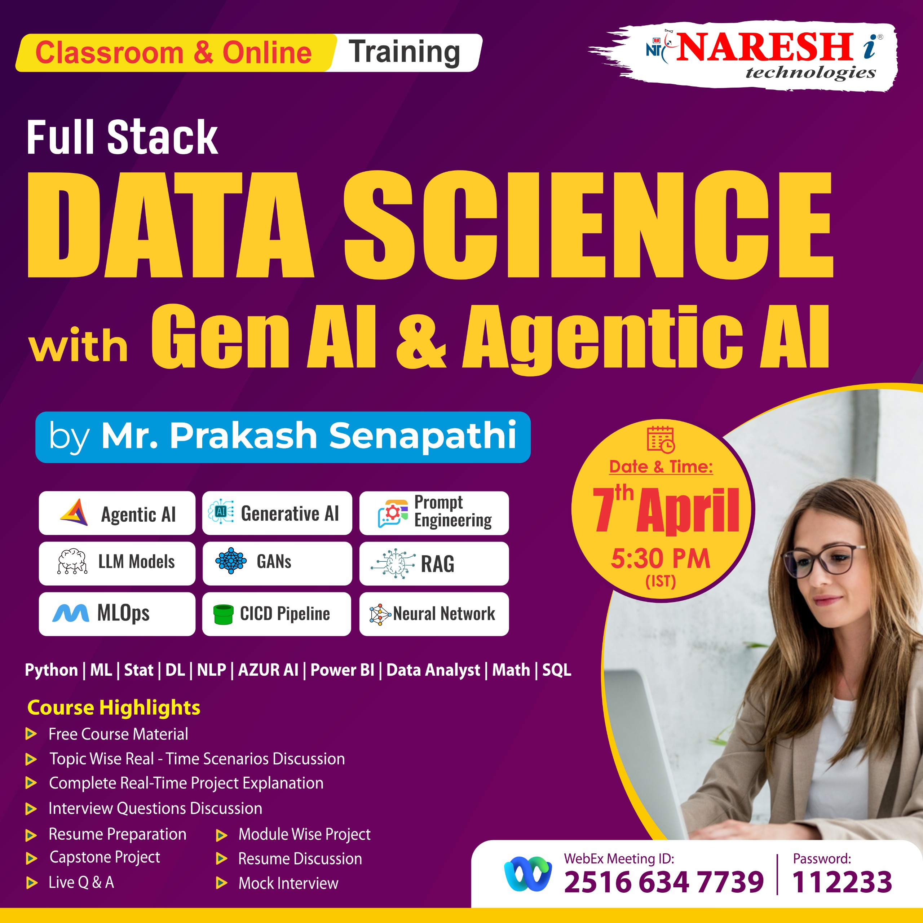
FSDS with Generative-AI & Agentic AI Starting Dt : 14th April @ 5:30pm Duration: Apr-Aug (6 month)
Joining URL:
https://web.webex.com/join-meeting
Meeting Id: 2516 634 7739
Password: 112233

Slide 4
WHAT IS SEABORN
Seaborn is a Python data visualization library based on Matplotlib that provides a high-level interface for drawing attractive and informative statistical graphics.

Slide 5
Key Features of Seaborn
Built on top of Matplotlib – It simplifies complex plots with just a few lines of code.
Works well with Pandas DataFrames – Automatically handles DataFrame structures and column names.
Beautiful default themes – Better aesthetics than Matplotlib out of the box.
Integrated statistical plots – Supports regression lines, confidence intervals, histograms, KDE plots, box plots, etc.
Multi-plot grids – Easy to create complex plots with FacetGrid, pairplot, etc.

Slide 6
Previous Workshop Title
1- Resume Building Bootcamp for Data Analytics, BA, Data Science & GEN AI Roles ➔
playlist?list=PLVlQHNRLflP-SaPff3325gkISMHEznEix
2- Agenitic AI ➔ playlist?list=PLVlQHNRLflP8Pt3wVlRWRaXZXi79cIwSq
3- Data Analytics & Business Analytics ➔
playlist?list=PLVlQHNRLflP-BgYmMlM8YQpvQM2J99HE0
4- Generative AI ➔ playlist?list=PLVlQHNRLflP81c99eg7UhkVZxwPvhTddM
5- Python for Data science ➔ playlist?list=PLVlQHNRLflP9GN5rc8sBWnrV53DWAzfdn
6- AZUR AI (Cognitive Services) ➔playlist?list=PLVlQHNRLflP8JthpjvJFaofUkJS1A7qa1
7- MCP ➔ www.youtube.com/watch?v=6Ll5uB8VQto

